Slide 1
LabVIEW Lesson Day1
Joe Kao
Application engineer, eCloudValley
2022/1/24

Slide 2

Speaker Introduction
Joe Kao, Application Engineer, eCloudvalley
National Taiwan University, Institute of Applied Mechanics
Expertise: Advanced Fluid Mechanics, Advanced Engineering Mathematics, LabVIEW
Notes:
建立一個存練習檔案的資料夾

Slide 3
Using Decision-Making Structures
Learn to create different decision-making structures and be able to identify applications where using these structures can be beneficial.
Case Structures
Event-Driven Programming
Notes:
這一章要談到Decision-Making的架構
這是State-Machine的基礎架構
Station Machine的狀態即是透過case來控制
在LabVIEW主要有Case structure和 Event-Driven Programming兩種

Slide 4
A. Case Structures
Recognize and use the basic features and functionality of Case Structures.
Case Structures Review
Selector Terminal Data Types
Input and Output Tunnels
Notes:
先簡單介紹Case structure
再來會介紹怎麼透過各種型別的資料來控制case
最後會談到output terminal的設定

Slide 5
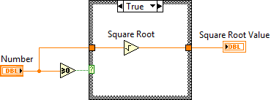
Case Structures Review
Notes:
類似if…else的語法 當條件觸發時再執行case structure內的程式 每一次只能執行一個case 這個重要的特性支撐後續的State Machine, Event Structure Case Select Label用來顯示現在是哪一個case Select Terminal則是連接條件和case structure的通道

Slide 6
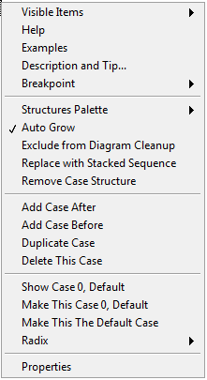
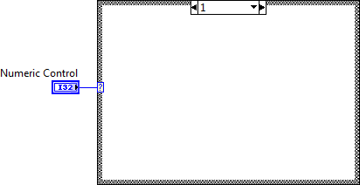
Demonstration
Create and configure case structures.
Notes:
Location: n/a – Start with a new VI.
1. Open a blank VI and create a Case Structure
2. Add a numeric constant to one case. 使用數字case
3. Right-click on the edge of the Case Structure and describe the different things that you can do from the shortcut menu 右鍵選單可以幹嘛
A. Remove or replace the structure. 可以移除或是取代
B. Add, duplicate, remove, or rearrange cases (if there are more than two). 可以調整、
C. Switch cases.

Slide 7
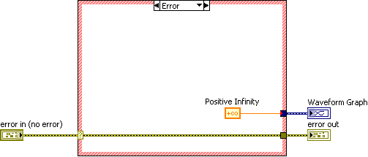
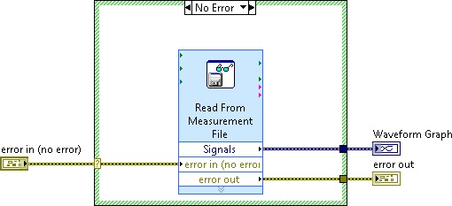
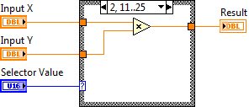
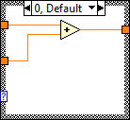
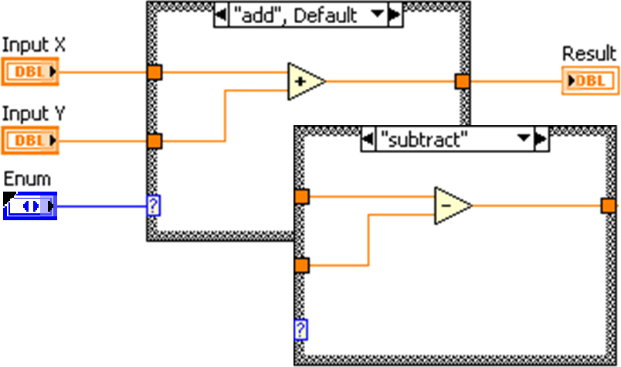
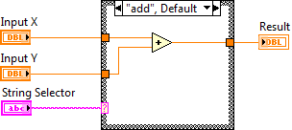
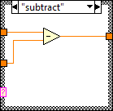
Selector Terminal Data Types
Notes:
Selector Terminal Data Types
• Boolean: Creates two cases: True和 False二種情況
• Integer or string – 可以根據需求設定多個case(EX:1, 2, 3或a, b, c)
O給定多少case就需要對應數量的case structure
o 一定需要有default
o 只能是正整數 (負數會進入Default case)
• Enums - 可以透過List的形式設定成對每個選項都有case
• Error Cluster - Error 和 No Error 會出現紅色跟綠色的框框

Slide 8
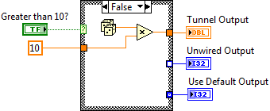
Input and Output Tunnels
Input tunnels are available to all cases if needed.
You must define every output tunnel for each case.
Notes:
和其他常見架構一樣，我們也可以設定Output Terminal
每個output tunnel都要對每個case有接線 如果有漏接的地方會呈現白色框框 程式執行處會呈現破碎箭頭
可以設定成Use default if unwired 呈現白色中心
以Numeric為case的話Default為0
Boolean為False

Slide 9
Demonstration
Create Case structures using different data type selectors.
Create different types of output tunnels.
Notes:
Location: <Exercises>\Demonstrations\Case Structures\Case Structures.vi
A pre-built VI with various selector terminal is available in the following demonstration folder:
• Show how wiring different data types to the selector terminal changes the case selector label.
預設是布林
要先接線才能設定case
不同資料型別選單會不一樣
一定要記得有預設case
未定義的integer或string輸入會進入default case 如果負數進來會進default
Enum新增選項

Slide 10
Exercise Temperature Warnings with Error Handling
打開Weather Warning.Ivproj
打開Temperature Warning.vi
打開Block Diagram建立Weather Data Cluster並Make Typedef後儲存
Unbundle by name取出Cluster內參數
加上Case Structure(Error, Max Temp<Min Temp?)
完成各Case端點

Slide 11
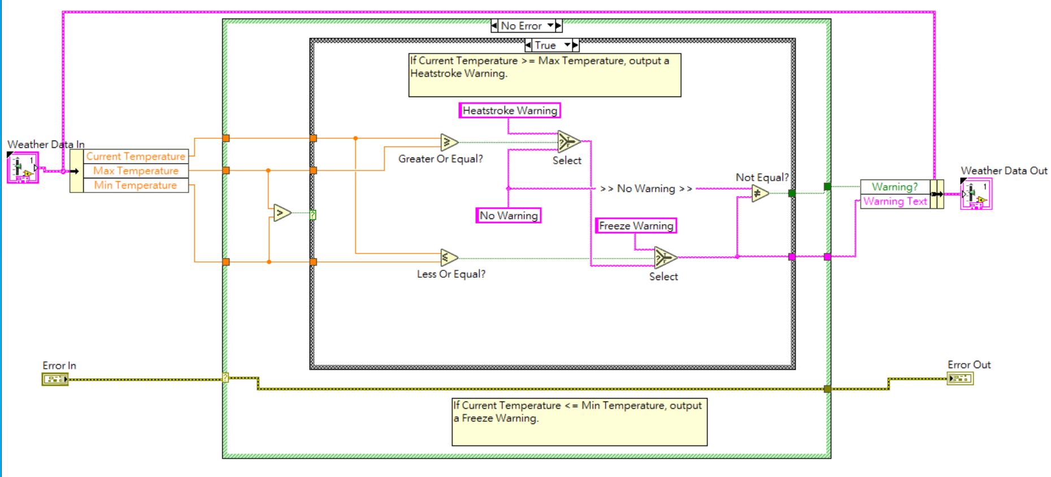
Exercise

Slide 12
B. Event-Driven Programming
Recognize basic features and functionality of event structures.
Event-Driven Scenario
Polling Versus Events
Event-Driven Programming
Configuring the Event Structure
Caveats and Recommendations
Notes:
這一張要講到Event Structure 架構上和Case structure相似
Event Structure 是透過UI上的事件來驅動
比方說按鈕的True False轉變 滑鼠點擊等等
再來會告訴大家Event Structure比起Polling有什麼好處 其中也會帶著大家一起做Event-Driven Programming的練習 最後會提到建立Event Structure要注意的一些事情

Slide 13
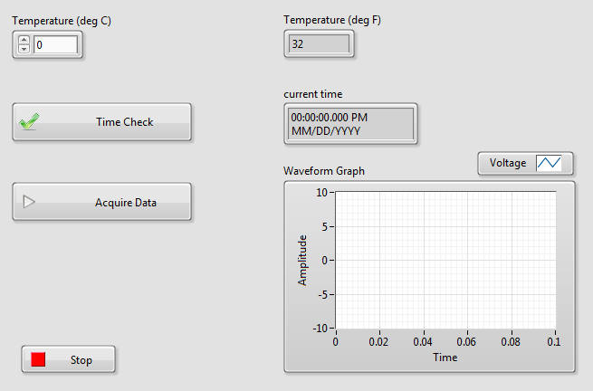
Demonstration Event-Driven Scenario
Notes:
Location: <Exercises>/Demonstrations/Event-Driven Programming/ Event-Driven Programming.lvproj
1. Open Event-Driven Scenario (Polling Method).vi. Only show the front panel. Do NOT show the block diagram yet.
2. Run Event-Driven Scenario (Polling Method).vi
3. Click the Time Check, Acquire Data, and Temperature (deg C) controls a few times to demonstrate that these front panel actions trigger block diagram code to execute (e.g. get current time, acquire waveform data, convert temperature unit). 按三個按鈕來讓程式動作
• Question: How would you implement this functionality in a VI? 讓學生想想看要怎麼做?
o Encourage students to suggest potential approaches.
o Based on what the students have learned so far, they would only know how to implement this functionality by constantly polling the front panel controls. 學生應該只能用polling

Slide 14
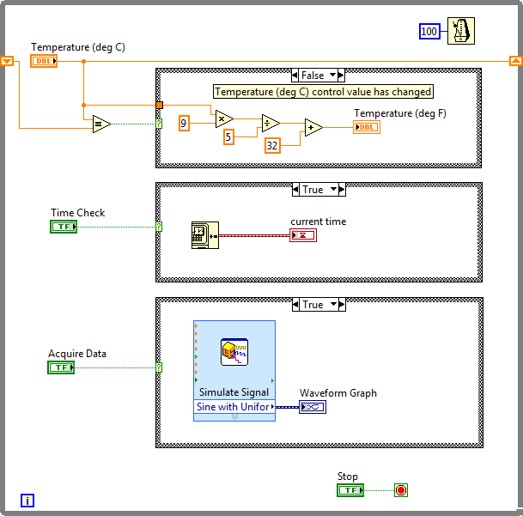
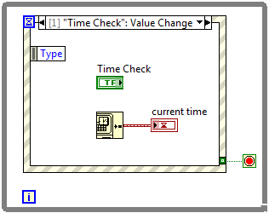
Polling Versus Events
Polling
Events
Notes:
Polling :持續檢查程式所以 CPU資源消耗大, 可能會漏掉變化太快的動作 ，做一堆case structure
Events :事件發生才會執行動作 所以可以節省CPU資源
一次只會進入一個event 根據事件發生的順序執行對應的行為 所以不會遺漏任何動作
所以以這個Demo來說event會是比較好的方式來實現這種應用

Slide 15
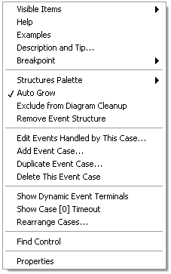
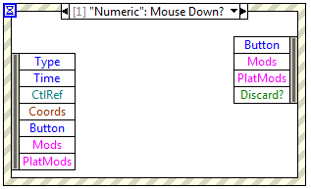
Configuring the Event Structure
Notes:
這個黃色的框框就是Event Structure
右鍵點擊他可以找到編輯它的選項 當然也還有增加 刪除等等功能

Slide 16
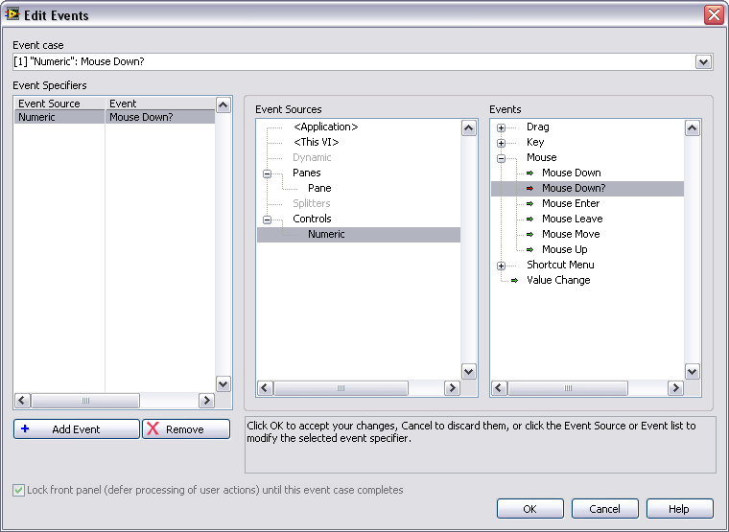
Edit Events Dialog Box
Configured Events
Events
Event Sources
Notes:
The dialog box is divided into 3 panes.
最左邊是顯示現在的event，包含source和事件
Event Source是用來觸發事件的元件 可以是按鈕 或其他control
Events是觸發事件的行為 例如Boolean button 的從True變成False等等
注意右邊的事件可以用UI產生或用程式產生

Slide 17
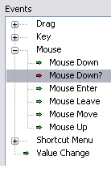
Notify and Filter Events
Notify Events
(green arrow)
Filter Events
(red arrow)
Notes:
notify even: 綠色箭頭
filter event:紅色箭頭
Focus on explaining the difference between Notify Events and Filter Events.
• Notify Events (green arrow) : Action 已經發生 LV已經處理
• Filter Events (red arrow) Action 已經發生 LV還沒有處理 並且可以用來覆蓋初始動作

Slide 18
Exercise Converting a Polling Design to an Event Structure Design
開啟Polling.vi，另存為UI_EventHandler.vi
建立一個Event Structure
設定STOP Event，觀察STOP 在Event Structure 內外的差異
設定Time Check Event
設定Mouse Down Event
Notes:
Open and run Polling.vi.
 Open the Events.lvproj file in the <Exercises>\LabVIEW Core 1\Events directory and open the Polling VI from the project.
2. Examine the performance of a polling VI using the Windows Task Manager.
 Press the <Ctrl-Alt-Delete> keys and select Start Task Manager from the menu.
 Click the Performance tab in the Windows Task Manager window.
 Run the VI.
Notice how high the CPU usage is.
 Stop the VI and notice how the CPU usage drops.
3. Open the block diagram, turn on execution highlighting, and run the VI again.
4. Notice how often the Time Check terminal sends data to the Case structure and how often the While Loop iterates.
5. Stop the VI and turn off execution highlighting.
Modifying the Polling VI to Use Events Instead of Polling
1. Save Polling VI as UI Event Handler.vi so you can modify it.
 Select Open additional copy and add the copy to the project.
2. Close Polling.vi.
3. Open the block diagram of UI Event Handler.vi and move the Stop terminal and the Time Check terminal outside the While Loop. You move these
terminals into the appropriate event cases later in this exercise.
4. Delete the Case structure and clean up any broken wires.
5. Place an Event structure inside the While Loop between the iteration terminal and the conditional terminal.
6. Right-click the Event structure and select Edit Events Handled by This Case from the shortcut menu.
7. Configure the event as shown in Figure 6-8.
8. Click OK to close the dialog box.
9. Place a True constant inside the new "Stop": Value Change event and wire it to the conditional terminal of the While Loop
1. Add a new event case and create a “Time Check”: Value Change event as shown in Figure 6-11.
 Right-click the event structure and select Add Event Case.
2. Run the VI.
3. Click the Time Check button to see the current time display in the current time indicator.
4. Display the Task Manager window and notice that CPU usage has decreased when you use events instead of polling.
5. Stop the VI.
Add a new event case and create a Mouse Down event as shown in Figure 6-12.
2. Run the VI.
3. Click on different parts of the front panel.
 Notice that the Coords indicator displays the coordinates for each point you click.
 Notice that the other events continue to behave as before.
4. Stop the VI.
Add a new event case and create a Panel Close? event as shown in Figure 6-13.
2. Save and run the VI.
3. Click the “X” at the top-right of the window of the front panel.
4. Notice that clicking the No button cancels the event and returns to the VI.
5. Clicking the Yes button stops and closes the VI.
6. Stop the VI if necessary.

Slide 19
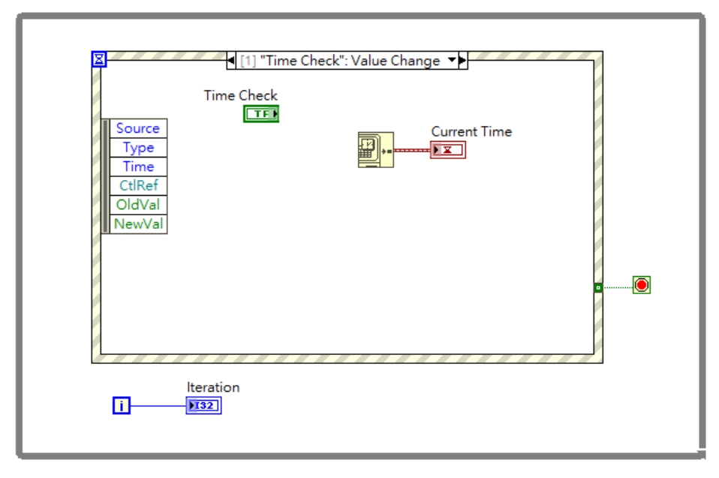
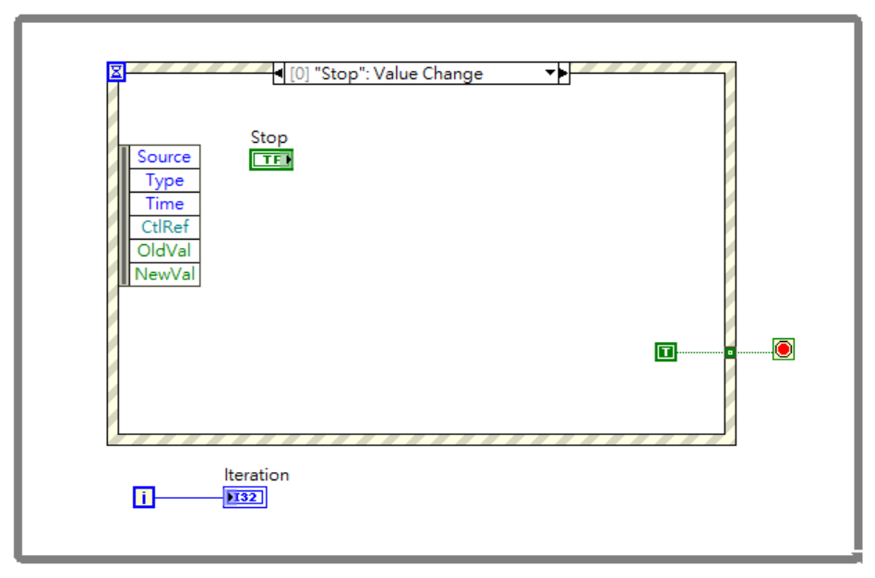
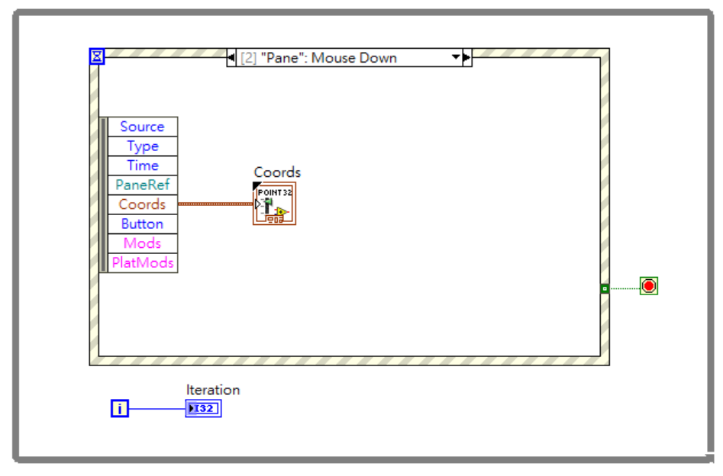
Exercise

Slide 20
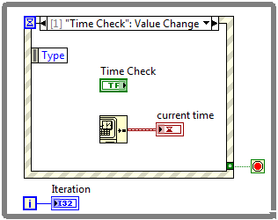
Caveats and Recommendations
Place only one Event structure in a loop.
Use a Value Change event to detect value changes.
Keep event handling code short and quick.
Place Boolean control terminals inside an event case for latched operations to work properly.
Avoid using an Event structure outside of a loop.
Avoid configuring two Event structures for the same event.
Notes:
ㄧ個loop中只放一個event
使用Value Change Event來捕捉控制元件的值變化
建議handling code(Time check)短一點
如果放boolean使用latch 並且放在Event Structure內
同一個event structure不要用相同的event

Slide 21
Modularity
Recognize the benefits of reusing code and create a subVI with a properly configured connector pane, meaningful icon, documentation, and error handling.
Understanding Modularity
Icon
Connector Pane
Documentation
Using SubVIs
Notes:
這個章節我們要談到模組化設計
也就是利用SubVI來實現 SubVI會包含Icon Connector Pane Documentation等部分 等等都會一一介紹到

Slide 22
A. Understanding Modularity
Recognize the benefit of using modular code and identify sections of code that could be reused.
Modularity
SubVIs
Notes:
模組化設計可以讓程式碼重複利用 用SubVI取代重複性高的程式碼也可以增加程式的可讀性 方便後續的維護

Slide 23
Modularity and SubVIs
Modularity — The degree to which a program is composed of discrete modules such that a change to one module has minimal impact on other modules.
SubVI—A VI used within another VI.
Notes:
LabVIEW 用subVI來完成模組化
SubVIs:
• 類似C++中的function
• 用右上角的connector pane來設定input和output
• Icon 可以幫助我們在main.vi中清楚知道subVI的腳色

Slide 24
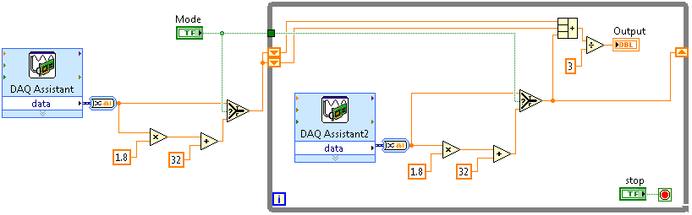
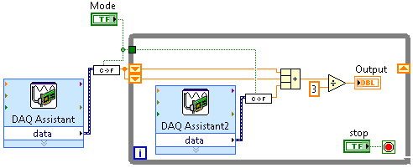
SubVIs—Reusing Code
Notes:
以這個攝氏華氏的轉換來看他們是一模一樣的程式 所以這樣的情況我們就可以把它做成SubVI 這樣程式碼就會看起來簡潔很多 而且Icon上用意義相符的圖案呈現可以幫助我們快速了解它的功能

Slide 25
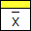
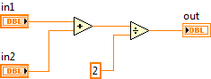
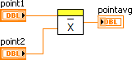
SubVIs
Function Code | Calling Program Code
function average (in1, in2, out) { out = (in1 + in2)/2.0; } | main { average (point1, point2, pointavg) }
SubVI Block Diagram | Calling VI Block Diagram
Notes:
一定會有icon和connector pane

Slide 26
B. Icon
Recognize characteristics of a good icon and use the LabVIEW Icon Editor to create a custom icon.
Characteristics of a Good Icon
Using the Icon Editor
Notes:
Icon 可以幫助我們快速辨別該SubVI的功能和特性

Slide 27
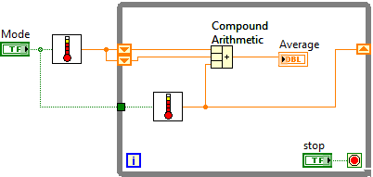

Purpose of Icon
Graphical representation of a VI
Identifies the subVI on the block diagram of the VI
Notes:
使用符合物理意義的Icon在block diagram中比較好辨識

Slide 28
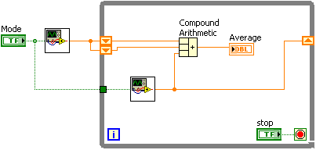
Characteristics of a Good Icon
Good icons convey the functionality of the VI.
Notes:
SubVI剛建立好的時候會預設Icon
盡量使用有意義的圖案和放上可辨識的文字
比方說我們要建立一個和溫度有關的SubVI就可以用溫度計當作Icon
比起預設的Icon更加簡潔明瞭 一眼就可以看出它的意義

Slide 29
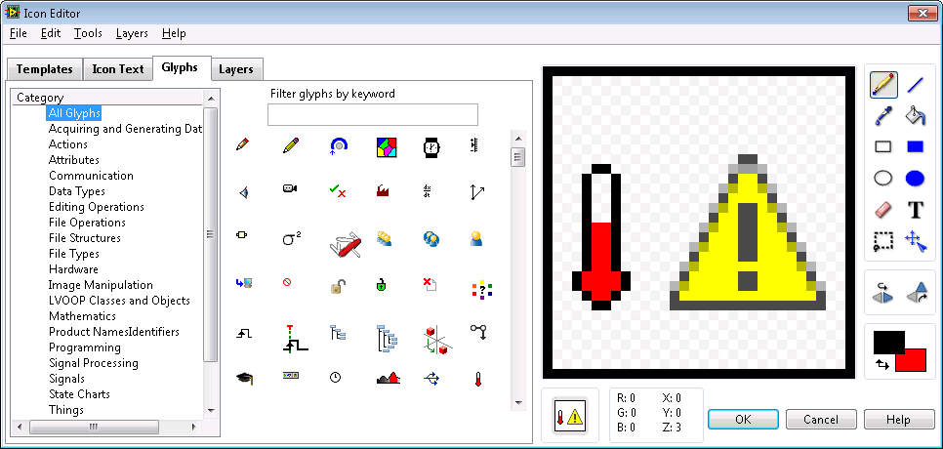
Creating Icons—Icon Editor
Notes:
Customize the icon so you can identify the VI when used as a subVI

Slide 30
Demonstration Creating an Icon
Use the LabVIEW Icon Editor to create a custom icon.
Notes:
Average Demo
Location: n/a – Start with a new VI.
Open a blank VI and demonstrate how to create an icon. Show each of the tabs and cover the following high points:
• Icon text and using colors
• Searching for glyphs
• Use templates to create a common look for related VIs, Example: DAQmx VIs.
一連串的ｓｕｂＶＩ可以使用ｔｅｍｐｌａｔｅ

Slide 31
C. Connector Pane
Select and configure a connector pane for a subVI.
Patterns
Standards
Notes:
設定SubVI的接腳位置和數量
Select and configure a connector pane for a SubVI

Slide 32
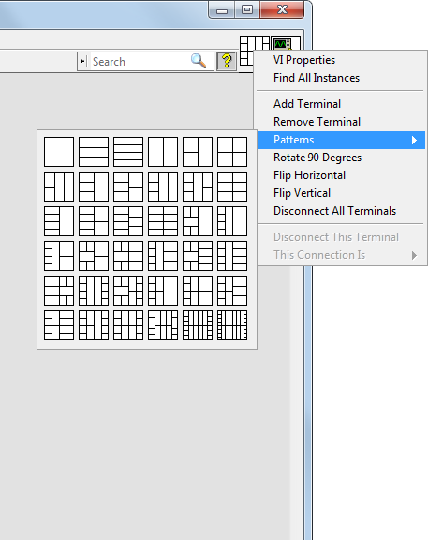
Patterns
Displayed next to icon
Select from different patterns
Notes:
有很多種選擇 最多28個腳位
預設是４２２４，但你自己可以做調整

Slide 33
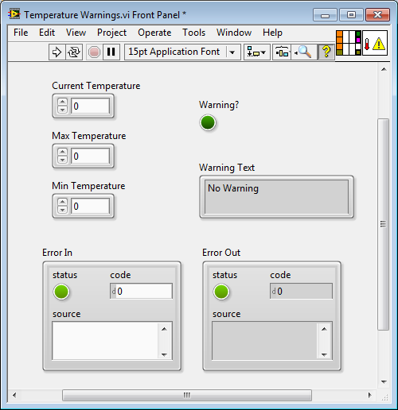

Assigning Terminals
Current Temperature
Warning?
Max Temperature
Warning Text
Min.Temperature
Error In
Error Out
Notes:
先點選右上角的腳位在選取Control Indicator

Slide 34
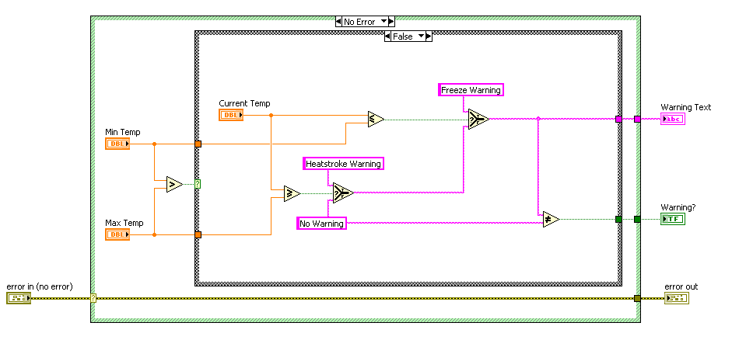
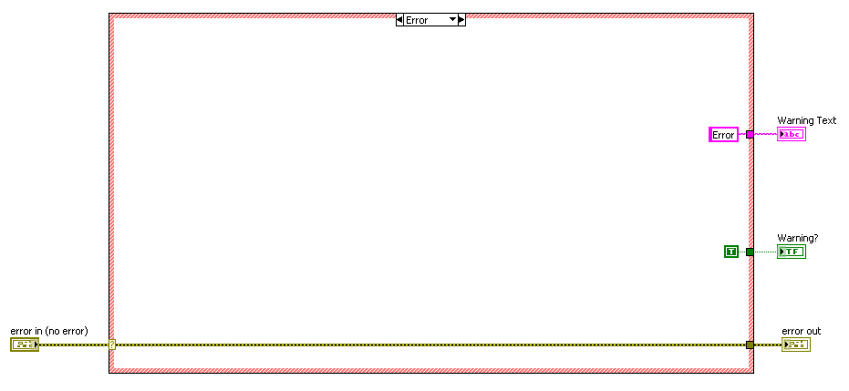
Handling Errors
Notes:
Error cluster穿過去後再建立SubVI

Slide 35

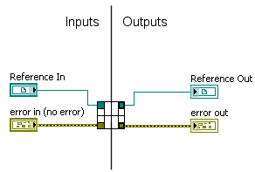
Standards
Notes:
建議的模式
中心線左邊是Input右邊是Output
Reference 型別會連接到最上面的腳位
ErrorIn ErrorOut會連到最下面的腳位
其他部分就是自己的輸入輸出資料

Slide 36
D. Documentation
Explain how to document code in LabVIEW using descriptions and tip strips, and describe four methods for documenting code on the block diagram.
VI Descriptions and Tip Strips
Labels
Notes:
製作完SubVI後
我們可以為它加上說明 讓其他使用者清楚這個SubVI的資訊細節

Slide 37
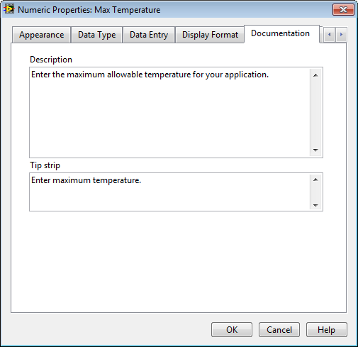
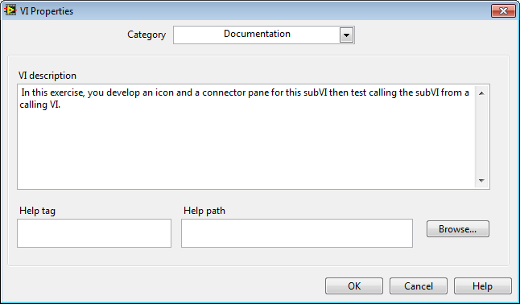
Creating Descriptions and Tip Strips
Notes:
右上角Icon右鍵 VI properties/Documentation
Demo

Slide 38
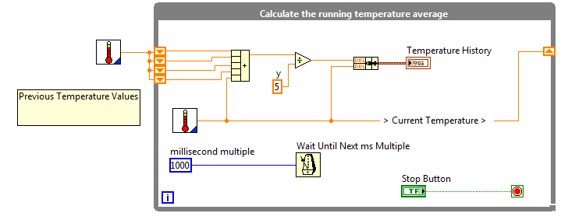
Documenting Block Diagram Code
Free label
Owned label
Notes:
註解:任意點2下
線段註解:右鍵/Visible Item

Slide 39
E. Using SubVIs
Demonstrate how to place subVIs on the block diagram, explain terminal settings and error handling, and create subVIs from a section of existing code.
Placing SubVIs on the Block Diagram
Terminal Settings
Handling Errors
Creating from a Section of Block Diagram
Notes:
接下來要介紹怎麼放置SubVI
放置後將Input Output接到對應的腳位
還有Error handling來處理Error

Slide 40
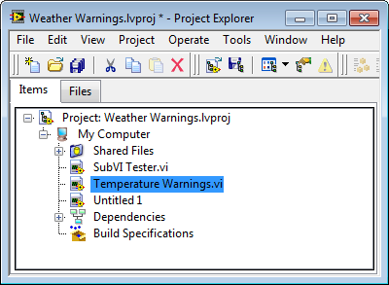
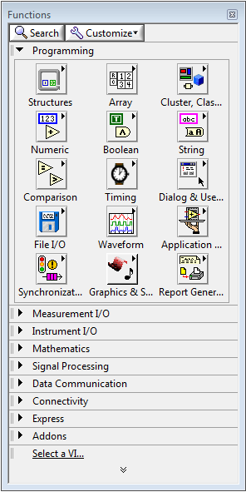
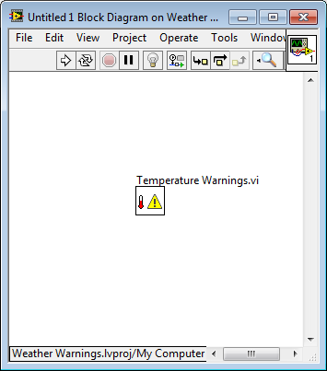
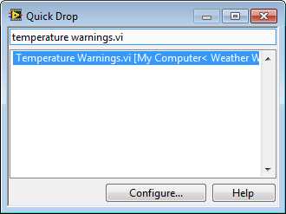
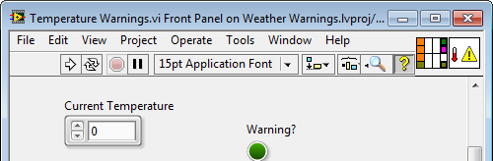
Placing SubVIs on the Block Diagram
Notes:
Placing SubVIs on the Block Diagram ［四種方法］
從專案中拉過去
在同一個專案中可以用Quick Drop或直接拉過去
右鍵/Select VI 在該SubVI右上角Icon拉過去

Slide 41
Exercise Temperature Warnings VI – As SubVI
將Temperature Warning.vi 做成SubVI
打開SubVITester.vi，放入Temperature Warning (SubVI), Thermometer(demo), WeatherData並接上
Notes:
1. Open Weather Warnings.lvproj in the <Exercises>\LabVIEW Core 1\Weather Warnings directory.
2. Open Temperature Warnings VI from the Project Explorer window.
3. Connect the inputs and outputs to the connector pane as shown in Figure 7-1.
Using the Wiring tool, click the upper-left terminal of the connector pane.
 Click the corresponding front panel control, Weather Data In.
 Notice that the connector pane terminal fills in with a color to match the data type of the control connected to it.
 Click the bottom-left terminal of the connector pane.
 Click the corresponding front panel control, Error In.
 Continue wiring the connector pane until all controls and indicators are wired, and the Context Help window matches that shown in Figure 7-1.
4. Create an icon.
 Right-click the icon and select Edit Icon
Use the tools in the Icon Editor dialog box to create an icon. Make the icon as simple or as complex as you want, however, it should be representative
of the function of the VI. Figure 7-2 shows a simple example of an icon for this VI.
Tip Double-click the Selection tool to select the existing graphic. Press the <Delete> key to delete the graphic. Then, double-click the rectangle
tool to automatically create a border for the icon.
Tip Double-click the Text tool to modify fonts. You can select Small Fonts to choose fonts smaller than 9 points in size.
Tip Select the Glyphs tab and filter the glyphs by the keyword temperature, then drag a thermometer glyph onto your icon. And then filter
by the keyword warning and drag a warning glyph onto your icon.
5. Click OK when you are finished to close the Icon Editor dialog box.
6. Save and close the VI.

Slide 42
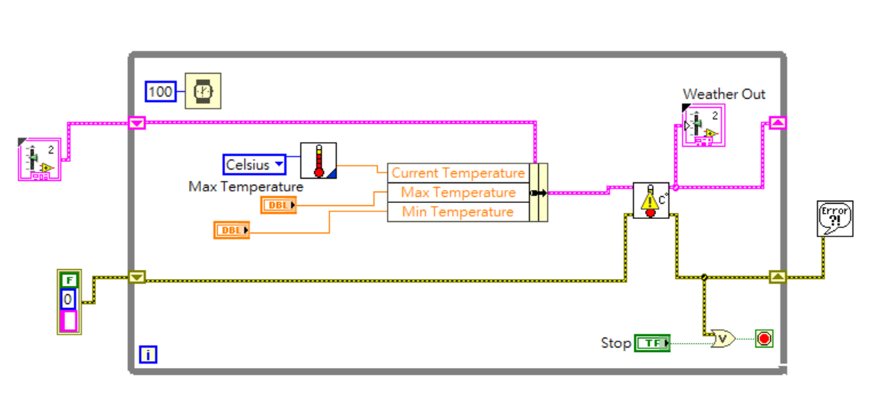
Exercise

Slide 43
Using State Programming
Describe the functionality represented by a state transition diagram.
Why Use State Programming?
State Transition Diagrams
Notes:
這一章要談到State Programming 也是今天的重點State Machine

Slide 44
Why Use State Programming?
Change the order of a sequence
Repeat an item in sequence more often than others
Execute only if certain conditions are met
Stop the program immediately
Notes:
比起使用Sequence，State Machine方便更改順序
可以重複同一個動作
可以條件式執行
可以在執行到中間的時候就停止

Slide 45
State Transition Diagram
State—Part of a program that satisfies a condition, performs an action, or waits for an event
Transition—Condition, action, or event that causes the program to move to the next state
Notes:
A state transition diagram is a type of flowchart that indicates the states of a program and transitions between states
Discuss the definitions of:
• State 真正要執行的部分
• Transition 透過條件判斷決定接下來要執行什麼的程式碼

Slide 46
State Transition Diagram
Notes:
這是我們等一下要做的Exercise的流程圖
是一個溫度示警的State Machine
圓圈是State
箭頭上的判斷式是Transition

Slide 47
State Machines
Determine when to use a state machine.
What is a State Machine?
When to Use a State Machine?
Building a State Machine
Event-Based State Machine
Simple State Machine Project Template
Notes:
接下來要討論State Machine 會講到什麼是State Machine 以及它的使用時機
還會帶大家一起建立一個State Machine

Slide 48
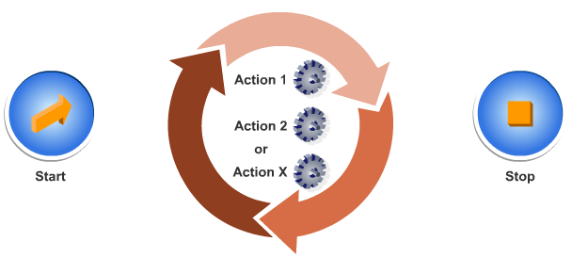
What is a State Machine?
Notes:
架構上會有Start Stop和中間的各種State和Transition

Slide 49
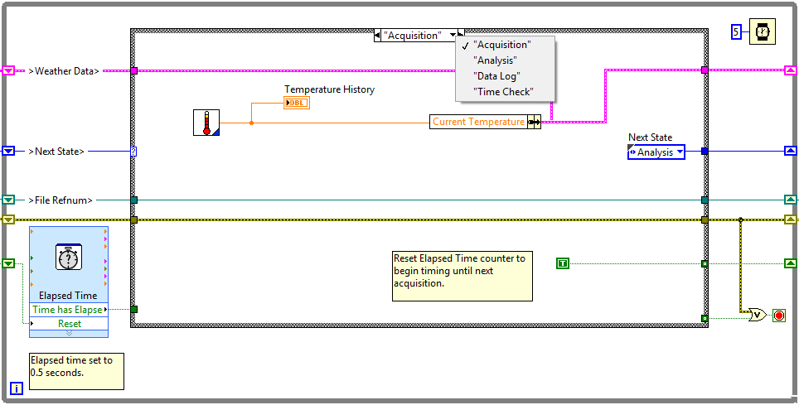
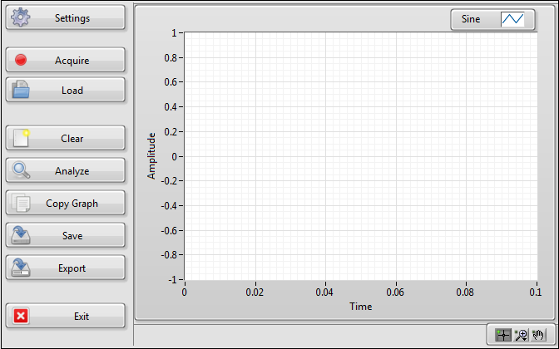
When to Use a State Machine
Sequential Process
UI-Driven Process
Notes:
適用於多個執行步驟的程式 如同前面提到因為Polling架構會大量消耗CPU資源而且當執行速度過快時可能會遺失動作
而State Machine在事件觸發才執行所以不會浪費CPU資源
而且是依據事件的觸發來決定執行順序
因此在這樣的情境下就適合使用State Machine的架構

Slide 50
Exercise
打開Weather Station UI.vi
放入Weather Data.ctl
建立Enum，包含Acquisition, Analysis, Data Log, Time Check，存為Typedef
設定Acquisition，放入Thermometer (demo).vi，取得Current Temperature，下一個State為Analysis
設定Analysis，放入Temperature Warning (SubVI)，連接Upper limit、Lower limit、Warning?和Warning Text，Warning?為True進入Data Log，False進入Time Check
設定Data Log，將前述資訊寫入檔案
設定Time Check，Time has elapsed 為True進入Acquisition，False進入Time Check，連接Stop button
Run vi

Slide 51
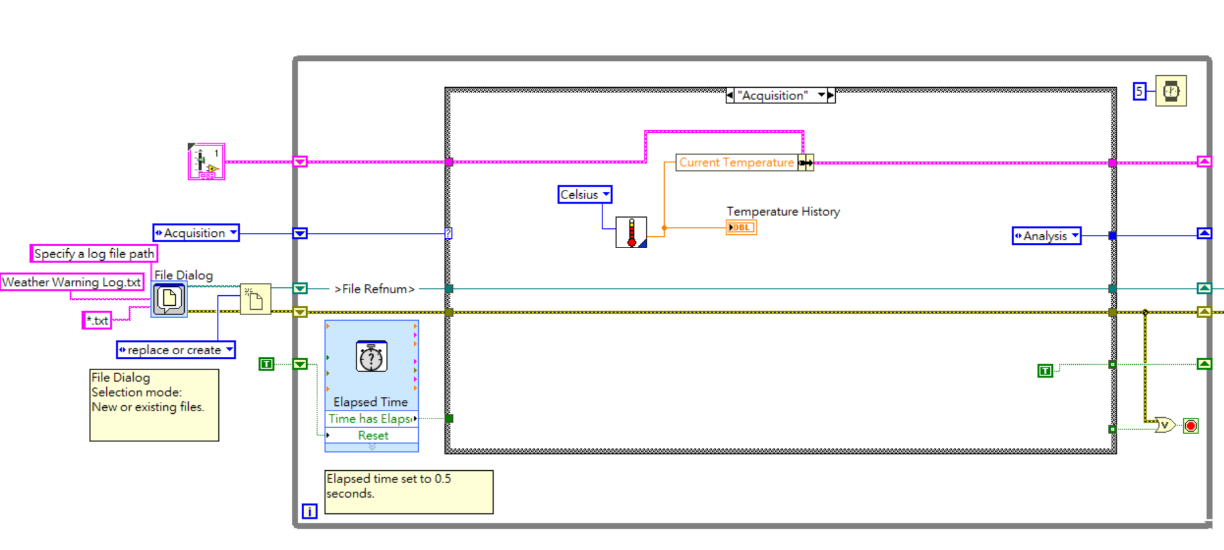
Exercise

Slide 52
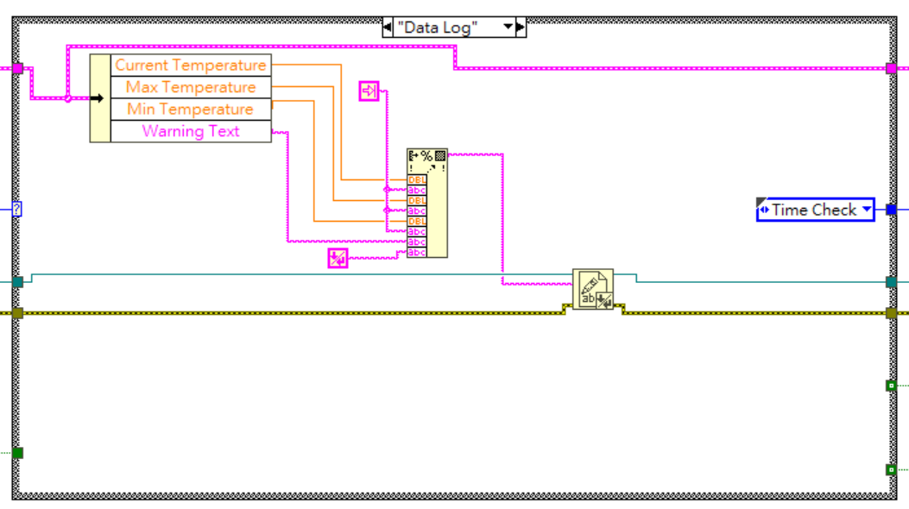


Exercise

Slide 53

Thank you for kind attention~
Joe Kao
Solution Team
Industrial Intelligence BU
E: joe.kao@ecloudvalley.com

